Slide 1

Introduction to Software Testing By Dr. Praveen Kantha

Slide 2
Software Testing

Slide 3
Integration Testing
Integration testing ("I&T") is the phase in software testing in which individual software modules are combined and tested as a group.
It occurs after unit testing and before system testing.
Integration testing takes as its input modules that have been unit tested, groups them in larger aggregates, applies tests defined in an integration test plan to those aggregates, and delivers as its output the integrated system ready for system testing.

Slide 4
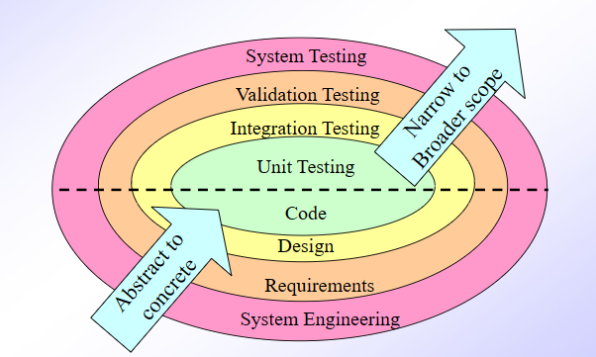
Why Do You Need Integration Testing?
To make sure that your components satisfy the fallowing requirements:
Functional.
Performance.
Reliability.

Slide 5
Bottom-up Integration Testing
In bottom up integration testing, module at the lowest level are developed first and other modules which go towards the 'main' program are integrated and tested one at a time.
Bottom up integration also uses test drivers to drive and pass appropriate data to the lower level modules.

Slide 6
Bottom-up Integration Testing
As and when code for other module gets ready, these drivers are replaced with the actual module.
In this approach, lower level modules are tested extensively thus make sure that highest used module is tested properly.

Slide 7
Top-down Integration Testing
Top down integration testing is an incremental integration testing technique which begins by testing the top level module and progressively adds in lower level module one by one.
Lower level modules are normally simulated by stubs which mimic functionality of lower level modules.
As you add lower level code, you will replace stubs with the actual components.

Slide 8
Stub and Drivers in Top Down and Bottom Up Testing
Stubs and drivers are actually computer programs that work as substitution of some computer module which are not available for testing.
Same as you want to test the high speed of the car but you don’t have traffic free long road available how you will test the speed of the car you may use the substitute of the road.
These Stubs and Drivers simulate the functionality of the other modules and allow us to perform the testing activity.

Slide 9
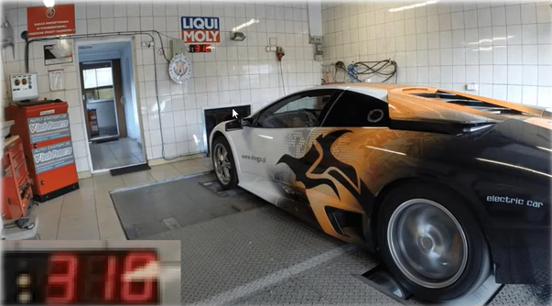
Stub and Drivers in Top Down and Bottom Up Testing

Slide 10
Stub
Now let's take a look on Stub and Driver Individually.
Stubs are basically use in Top-Down approach of Integration testing, When you have upper modules prepared but you don’t have the bottom modules.
Now you can’t test the upper modules without the bottom modules so just for tasting phase instantly you make the simulation of bottom modules and check the working of upper module with bottom modules.
These are kind of dummy programs, Simulating the functionality.
We call them in place of original program.

Slide 11
Drivers
Drivers are the programs which we use to call the other program, May be you will use a driver to call any stub.
In other words you can say it’s a main program through which other modules are called.
As we know to run any module, we always need a main program so driver is that main program.
We use the driver in bottom up approach when bottom level modules are prepared but top level main program is not prepare so we prepare a drive to perform task.

Slide 12
integration-testing Tools :
Mockito is an open source testing framework for Java.
Jasmine is a development framework for testing JavaScript
FitNesse is an open source framework in which software testers, developers.
Steam, developed by GitHub, is an open source framework used to test JavaScript-enabled websites.
LDRA tools are used for integration testing for organizations requiring verification to compliance standards.

